Slide 1
Recursion
Simplifying a Problem By Asking Yourself for the answer

Slide 2
What is Recursion?
Recursion: Calling a method from within itself to solve a smaller version of the original problem.
E.g. To sort an array, repeatedly partition it, then call partition on both sides of the partitioned space.
Recursion is based on two components:
Base case: When to stop recursing.
Recursive case: How the program reduces the problem and calls itself again.

Slide 3
The Structure of a Recursive Method
To develop a recursive method, you need to identify:
Base case: What is the simplest version of the problem?
Recursive case: How do you simplify the problem? How do you combine the results?
Both are essential!
Without a base case, your method will spiral into an infinite loop
Without a recursive case, you won’t calculate the correct result

Slide 4
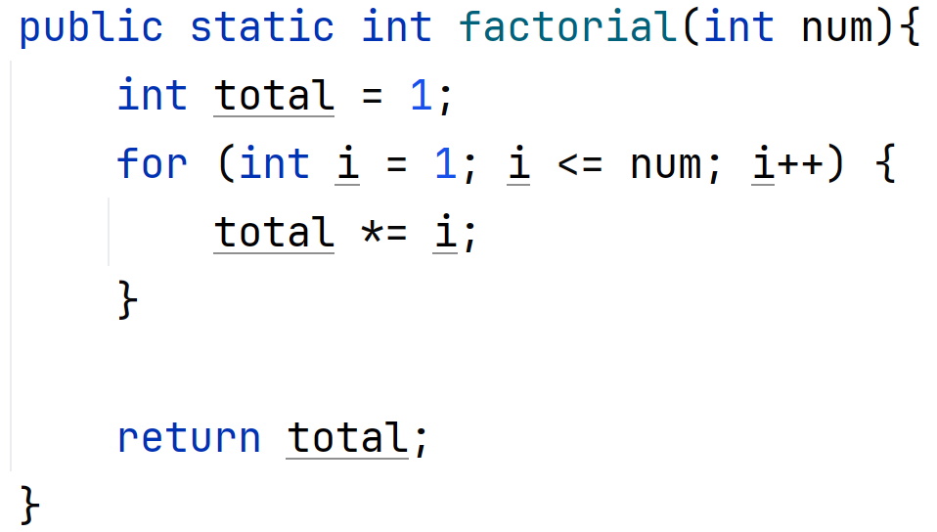
A Simple Example of Recursion: Calculating the Factorial (!)
n! = n * (n-1)!
E.g. 5! = 1 * 2 * 3 * 4 * 5 = 120
Iterative solution:
Start running total at 1
Loop through the values up to the supplied number (inclusive)
Multiply total by the next value in the loop
Return the final total

Slide 5
Simple Recursive Example: Designing the Recursive Case for Factorial
To create a recursive solution, we need to identify:
The recursive case
The base case
Recursive case: a smaller subproblem that looks the same as the original one
E.g. n! = n * (n-1)!
If we want to solve this recursively, we should:
Decrease our current number by 1 and call our method again
Multiply the result of this by our current number
Why is this important?
Smaller version of the original problem!

Slide 6
Simple Recursive Example: Designing the Base Case for Factorial
The base case is often the hardest part of designing a recursive method
How do you know when to stop your recursive loop?
What do you return when you stop?
Base case: The smallest input value we can get – this should be where we know the correct answer.
This is often when the data has reduced to 0 or 1
Factorial’s smallest valid input is 0
0! is 1
if input == 0, return 1

Slide 7
Simple Recursive Example: Combining Results From Recursive Calls
Once you know how to:
Reduce the data to be passed into the next recursive call
Stop the cycle with the base case
You may need to combine the results from the recursive calls
This is not always required
For factorial, we need to combine the result of the recursive case with our current value and return it:
return n * factorial(n-1)

Slide 8
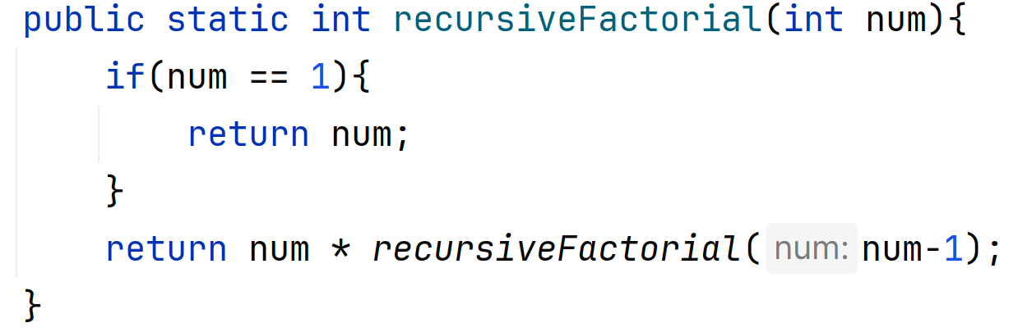
Simple Recursive Example: The Complete Solution
Base case
Combining results
Recursive case

Slide 9
Tracing a Recursive Call
If n = 4
Call 1: return 4 * factorial (4-1)
What is factorial (n-1)? We don’t know, so…
Call 2: return 3 * factorial (3-1)
What is factorial (n-1)? We don’t know, so…
Call 3: return 2 * factorial (2-1)
What is factorial (n-1)? We don’t know, so…
Call 4: return 1 * factorial (1-1)…
What is factorial (n-1)? We don’t know, so…
Call 5: n==0
We’ve reached the base case!
Now we can stop triggering calls and just return 1
Base case lets us climb back up the ladder
Call 4: return 1 * (1) = 1
Call 3: return 2 * (1) = 2
Call 2: return 3 * (2) = 6
Call 1: return 4 * (6) = 24
Final answer: 24!

Slide 10
Challenges!
Calculating Fibonacci numbers
Reminder: Fibonacci numbers are a sequence of numbers where each value is the sum of the previous two, i.e. F(n) = f(n-1) + f(n-2)
Calculating the sum of all numbers in an array
Reversing a string
Calculating the sum of all digits in a number
Counting the number of times a specified character appears in a String
Calculating x to the power of y.
Checking if a string is a palindrome

Slide 11
Types of Recursion
Direct recursion: Method calls itself
Indirect recursion: Methods call each other in a loop (e.g. menu() -> handleRequest() -> menu())
Tail recursion: Recursive step is done last in the method
Some languages can optimise this approach to reduce the impact on the call stack – keeps the growth to a manageable level!

Slide 12
When to Use Recursion
Recursion can make the code much simpler
Design process is harder, but the code is often much cleaner
Recursion is ideal for situations where the problem can be decomposed into smaller versions of the same problem, e.g.:
Divide and conquer algorithms
Data structures containing nested structures, e.g. trees

Slide 13
Common Situations for Recursion
Maths problems:
E.g. Factorial, Fibonacci, power functions.
Divide and conquer algorithms:
E.g.: Merge sort, quicksort, binary search.
Tree traversals:
E.g.: Inorder, preorder, and postorder traversal.
Backtracking algorithms:
Solving mazes (look at smaller and smaller area of maze, go back a step if that section doesn’t contain an exit), n-queens problem.

Slide 14
The Down Sides of Recursion
Recursion is more expensive than iterative approaches
Every recursive call costs memory as it must be pushed to the call stack
Without optimisation, recursion can be a slower approach
Can’t skip around as easily

Slide 15
Memoization: Optimising Recursion
Memoization: Caching results of previous recursive cases
If we have a cached result, we can use this instead of continuing down the recursive stack.
This requires us to maintain state across calls to recursive methods.
Can be a static variable or be part of an object.

Slide 16
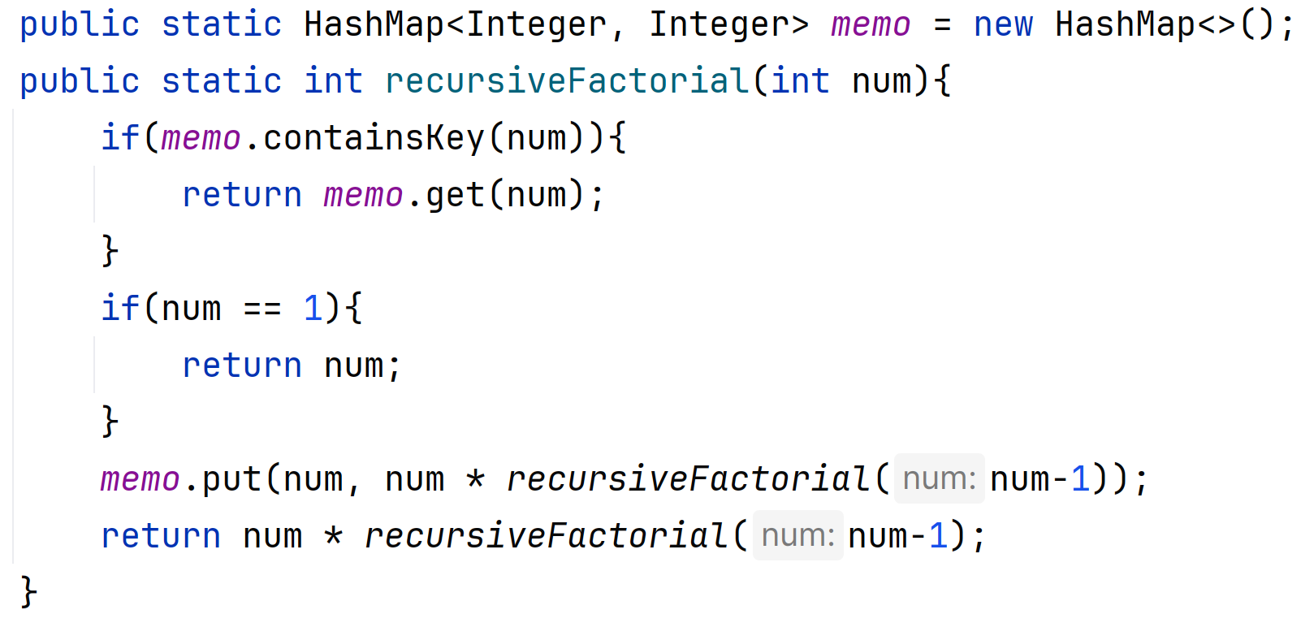
Example: Optimising Factorial with Memoization

Slide 17
Recursion: The Common Mistakes!
Infinite loops: Forgetting the base case/having an incorrect base case will result in infinite recursion and endless loops
Stack Overflow: The problem is not reducing fast enough.
e.g. There are too many recursive calls needed to solve the problem, without memoization to improve it.
Overuse : Recursion is great, but it’s not always needed!
If you have to work hard to force a solution, you probably should stick with iterative.

